Slide 1
LeaseWithEase RENTAL SERVICES (White Goods Rental Services)
Project Presentation Presented By
Sumit Patkulkar -220945920102
Reva Sakpal-220945920072
Rahul Wagh-220945920070
Rohini Kuwar-220945920073
5.Pratiksha Chavhan-220945920024

Slide 2
Why LeaseWithEase?
Shifting from one City to Other city for the Education purpose or for job
Buying new appliances may be costlier
Keep eye on maintenance

Slide 3
What you get?
Hassle Free Relocation
24 * 7 Online Booking for Product buy on rent
Refundable Security Deposit
Door Step Delivery & Pick up
Cuts Businessman’s(Admin) workload

Slide 5
Modules We Covered
Customer Management
Transporter Management
Product Management
Order Management
Stock Management
Report Management
Delivery of product management
Feedback Management
Payment to Transporter Management

Slide 6
What is Role of Admin in the System?
Admin is a business owner who wants to sell his products on rental basis.
He will be responsible for managing all products by there categories.
The images uploaded by admin will get display on website.
He will authenticate transporter for delivery purpose.
Stock maintenance will be done by him with help of stock management.
He will get deposit amount on each booking.
Deposit amount will be refunded by him after order period get finished & product received back.
He will be look after complaints & feedbacks.
He will be authorised to accept any order or cancel the same.

Slide 7
What is Role of Customer in the System?
Any anonymous User will be able to view different products available for rent.
Consumer will able to register on portal to book required goods to rent.
Registered consumer will be able to view, add or remove products from shopping cart.
Registered Customer will be able to cancel placed order within 24 hours.
Registered customer can pay deposit amount before order booking.
Register customer will get monthly invoice for rent EMI.
Registered customer can post feedbacks & registered complaints.

Slide 8
What is Role of Transporter in the System?
Admin will register any transporter on portal.
Transporter will have all access credentials in confirmation mail.
He can login the portal using there credentials .
He can view pending orders to delivered , can generate challan & can update delivery status.
He will have facility to view receivable pending payment details for delivered orders.
Transporter will delivered & pick up the products from customers

Slide 9
User Friendly UI
&
Operations

Slide 10
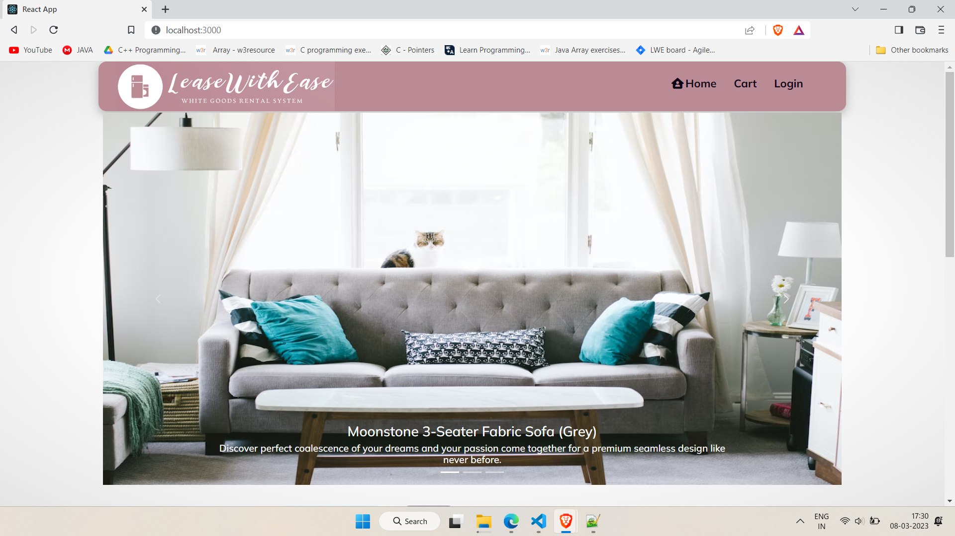
Home Page

Slide 11
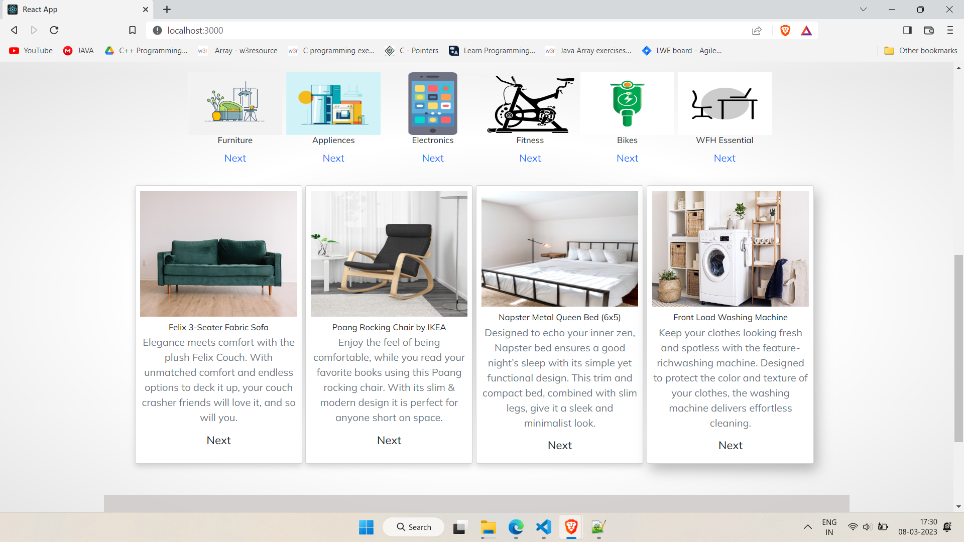
Available Product Category :

Slide 12
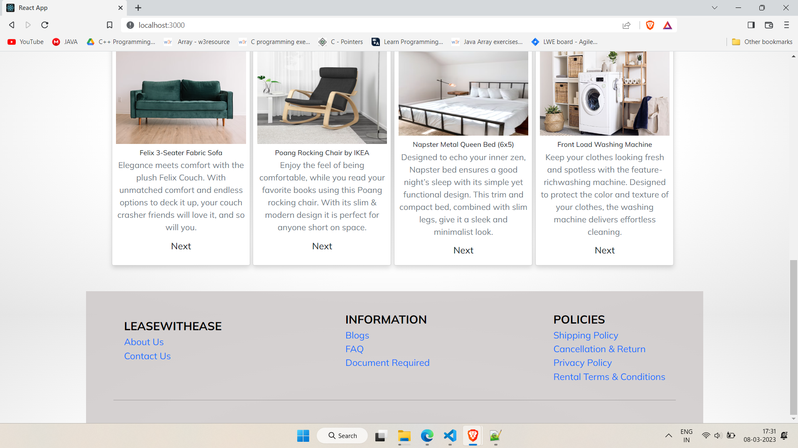
Informative Pages:

Slide 13
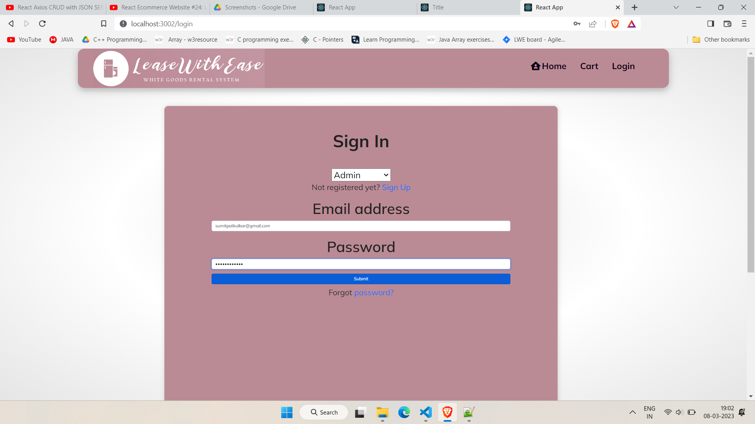
Sign in for Admin, Customer & Transporter:

Slide 14
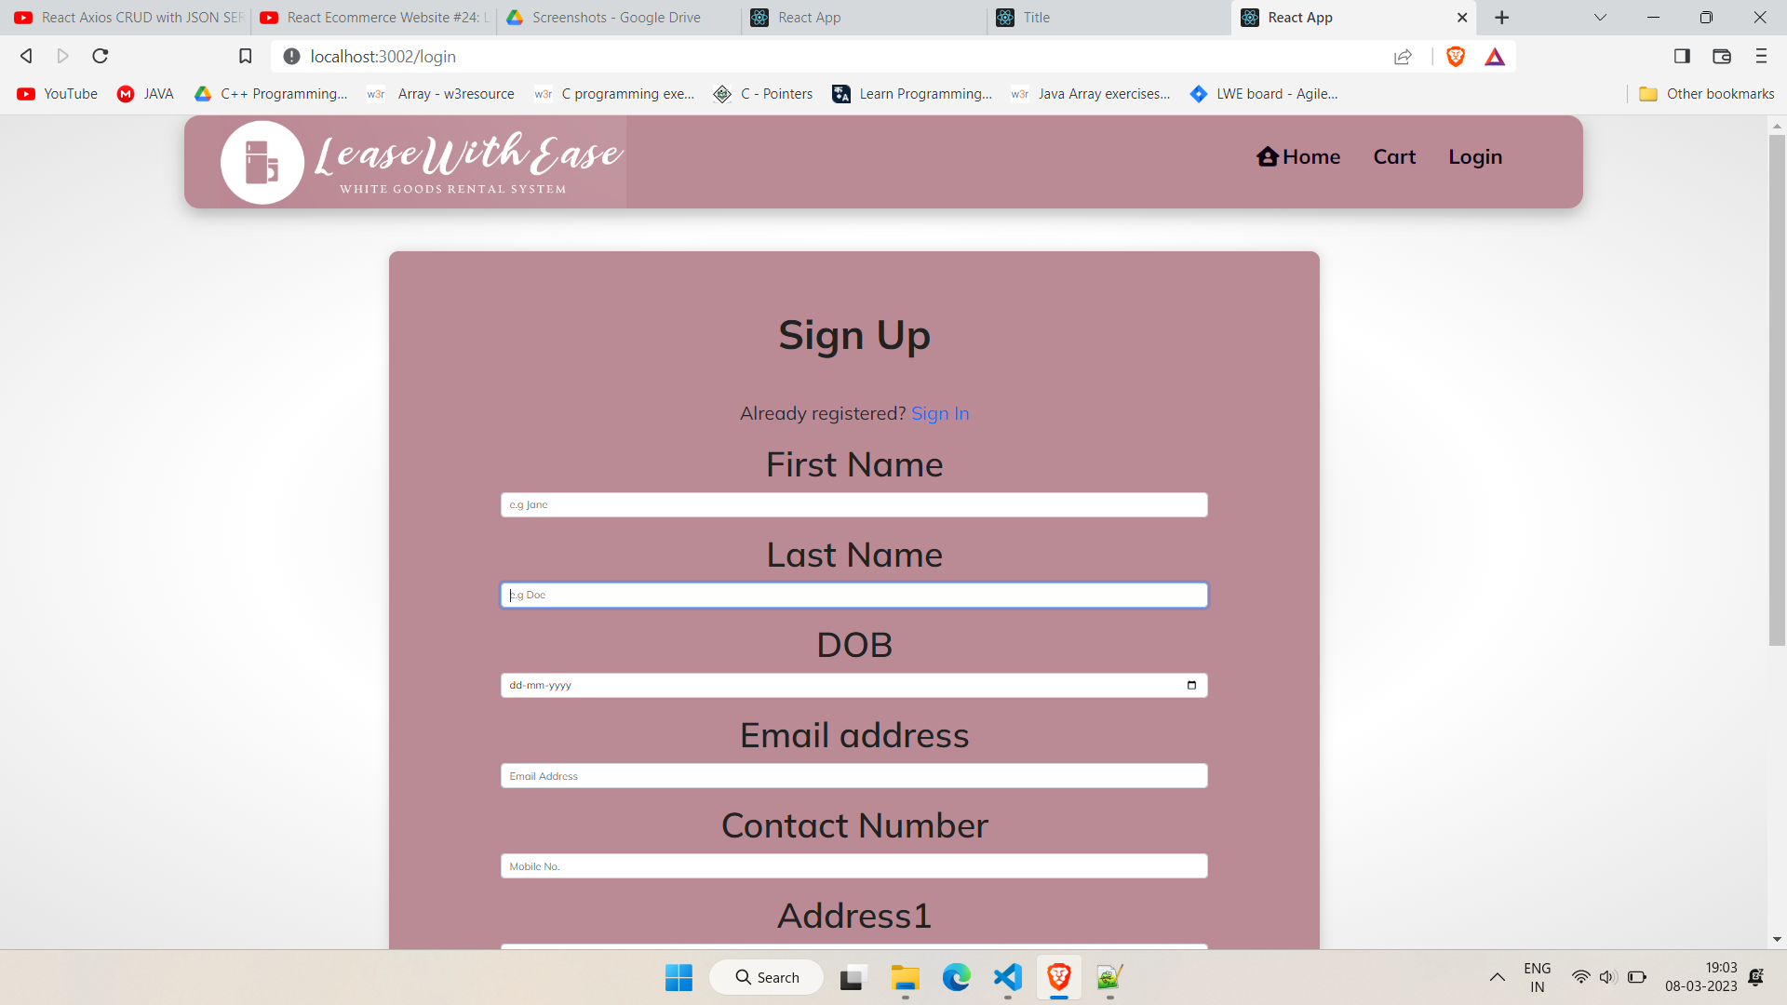
Sign up for Customer:

Slide 15
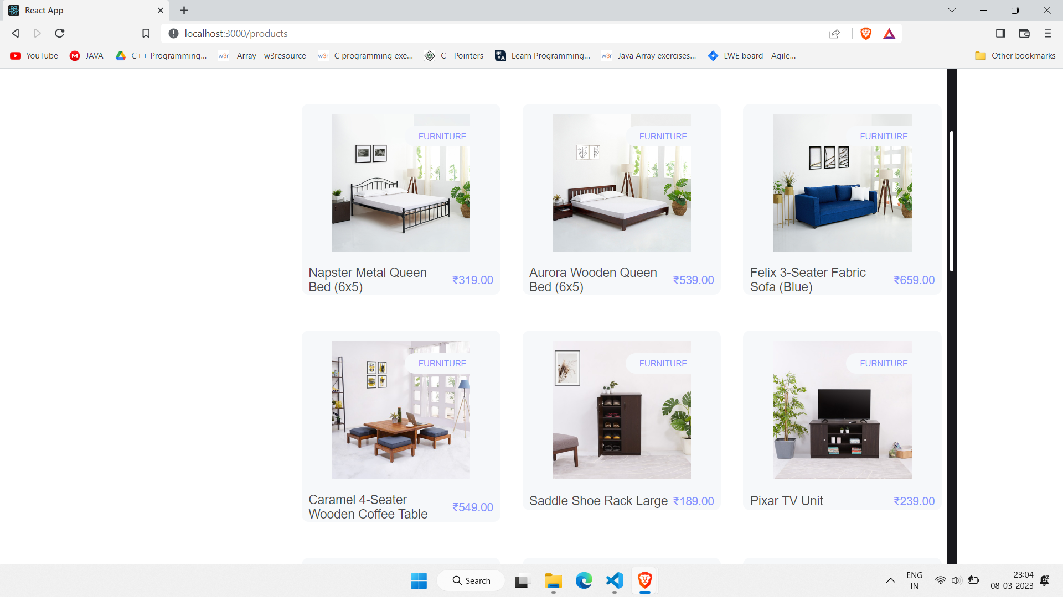
Category wise Products

Slide 16
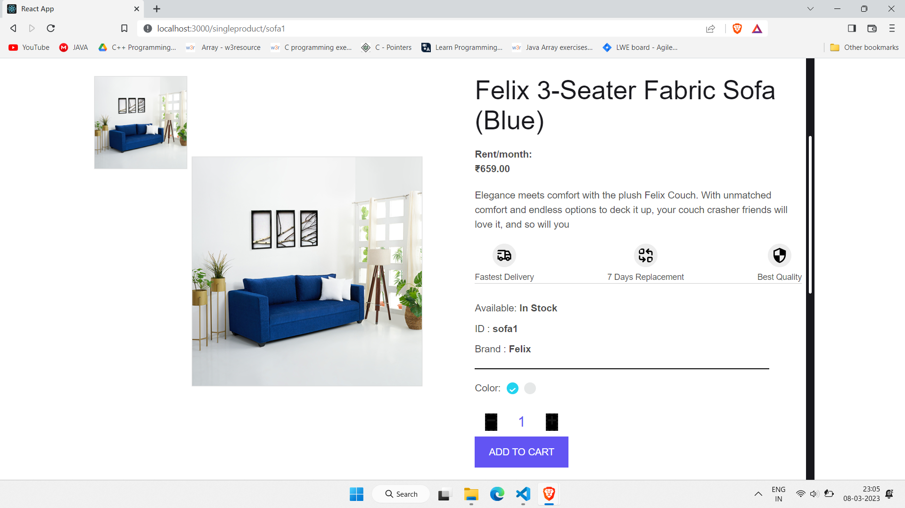
Product Specification

Slide 17
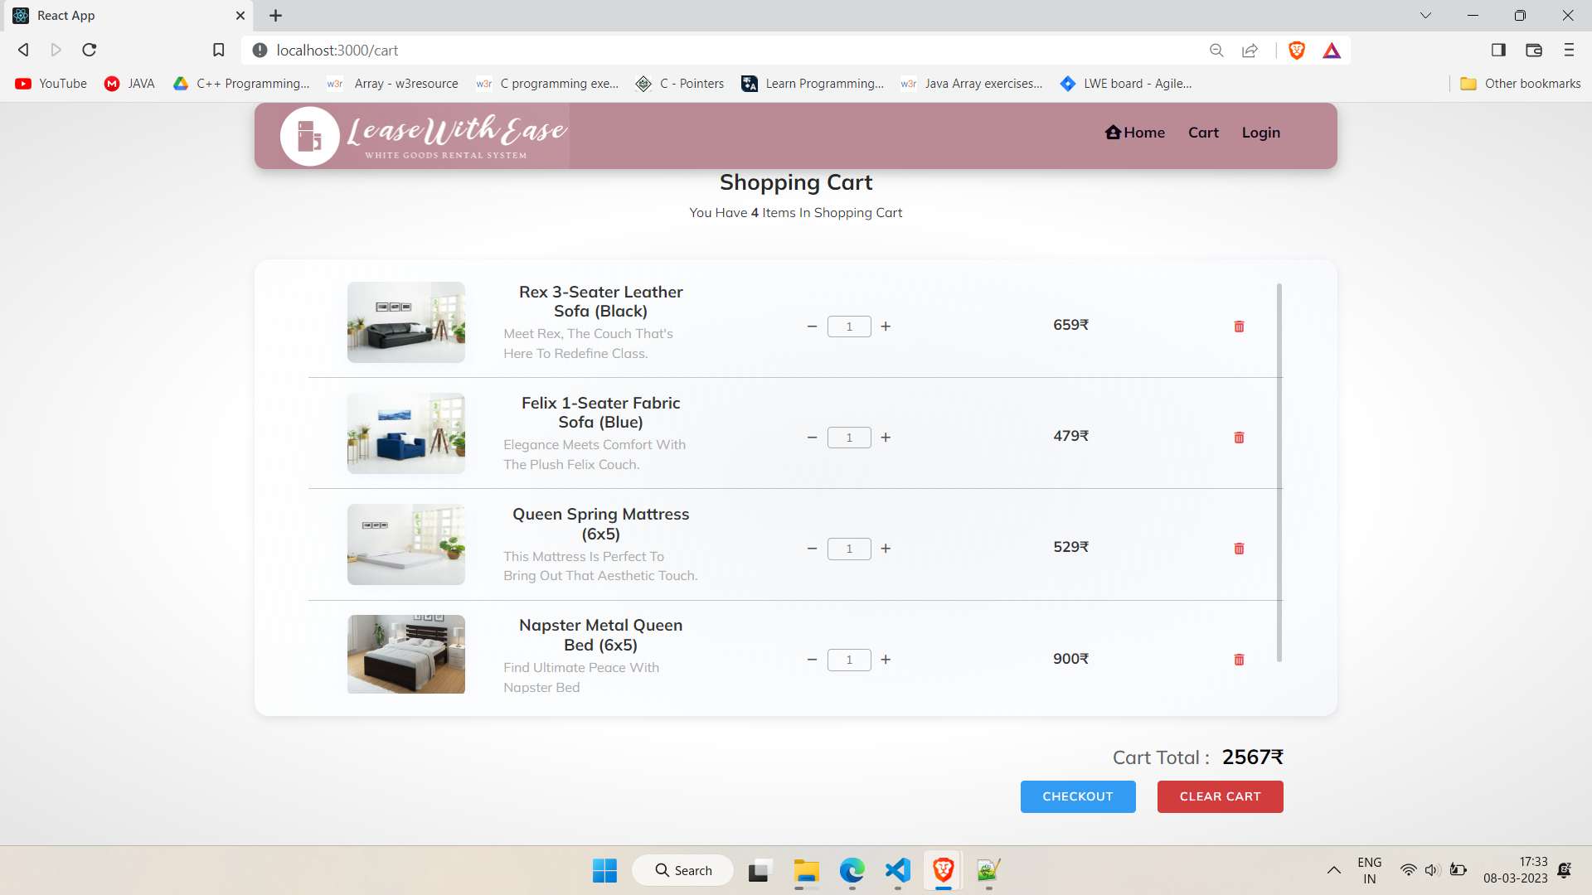
Cart

Slide 18
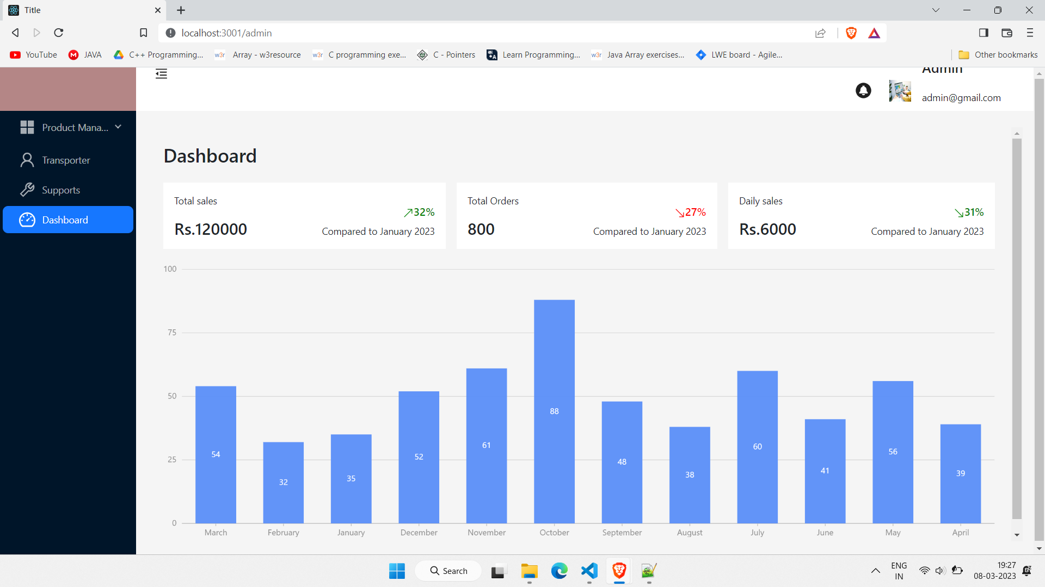
Admin Dashboard

Slide 19
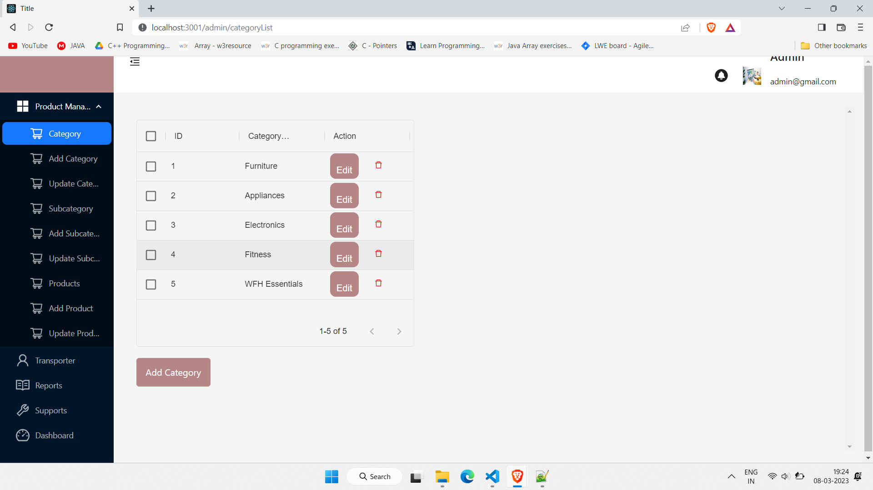
Product Management(Categories)

Slide 20
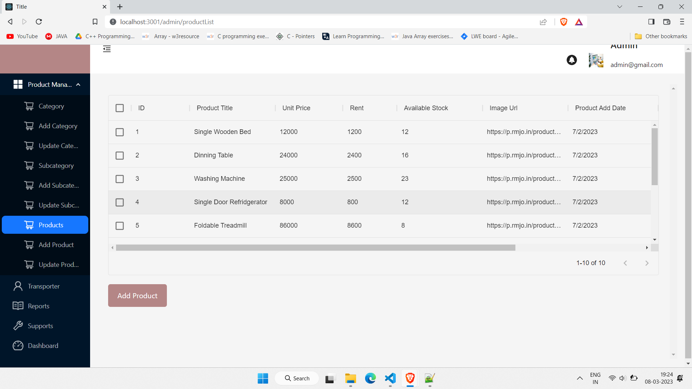
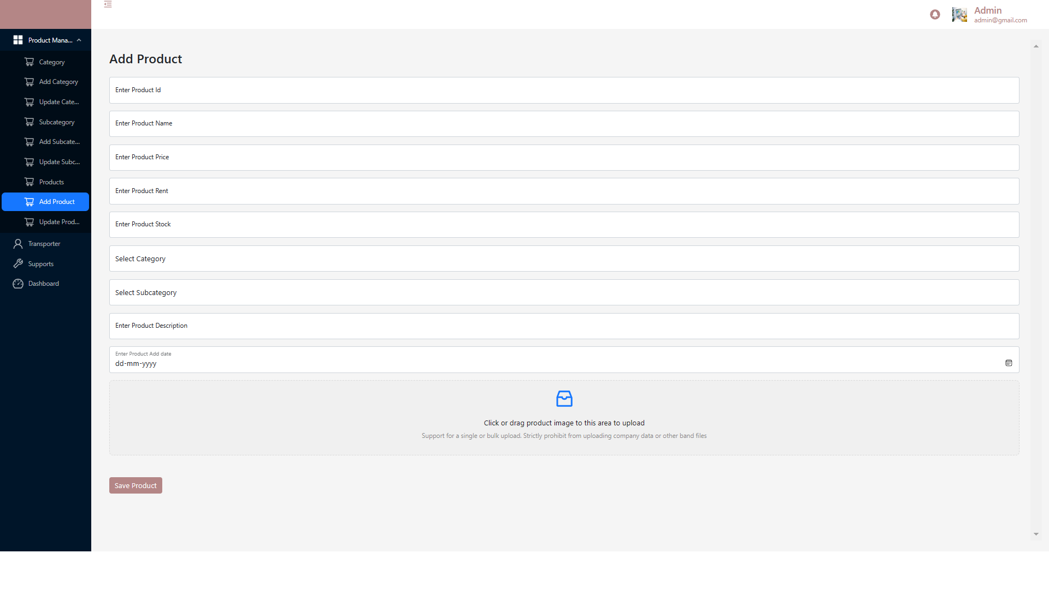
Product Management(Product)

Slide 21
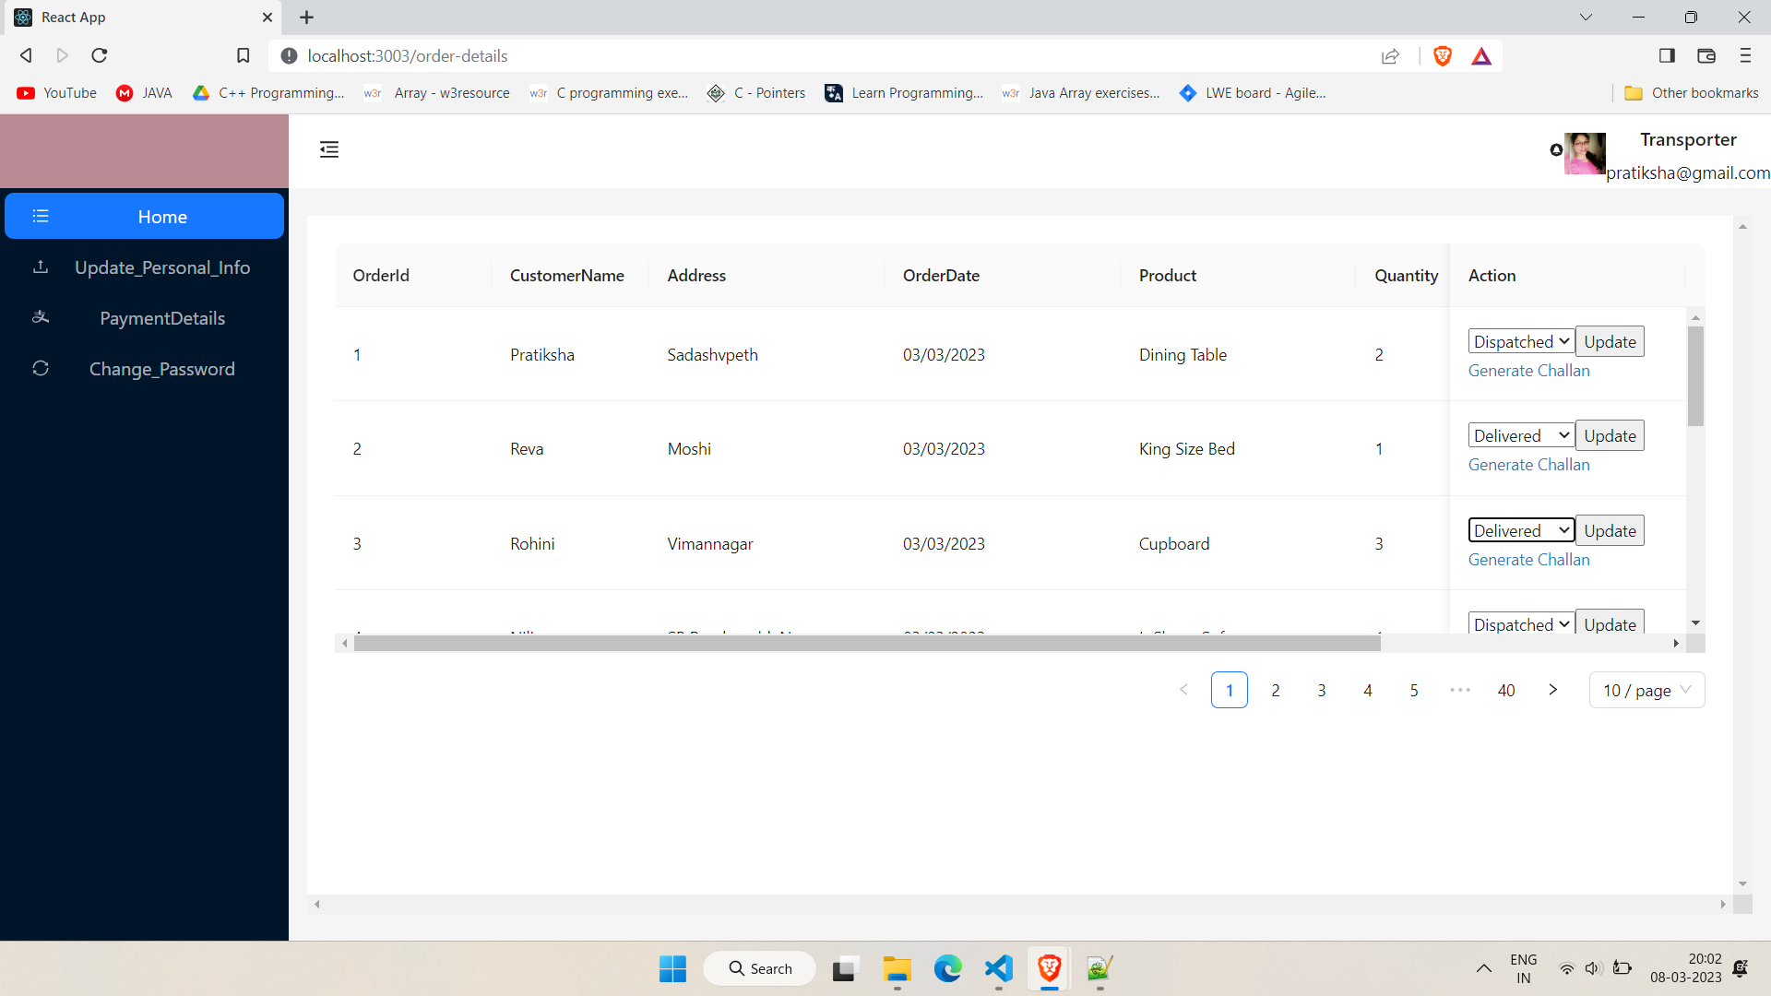
Transporter Dashboard

Slide 22
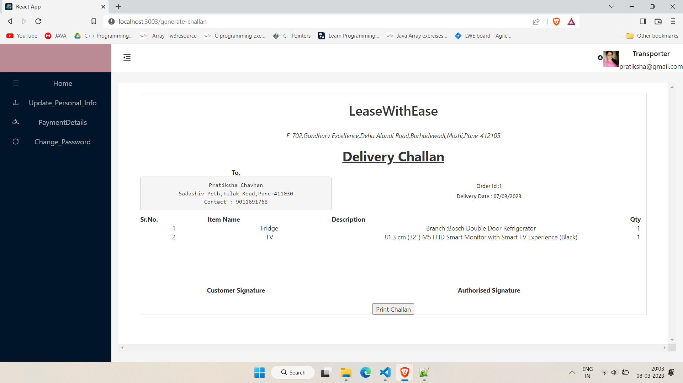
Generate Challan

Slide 23
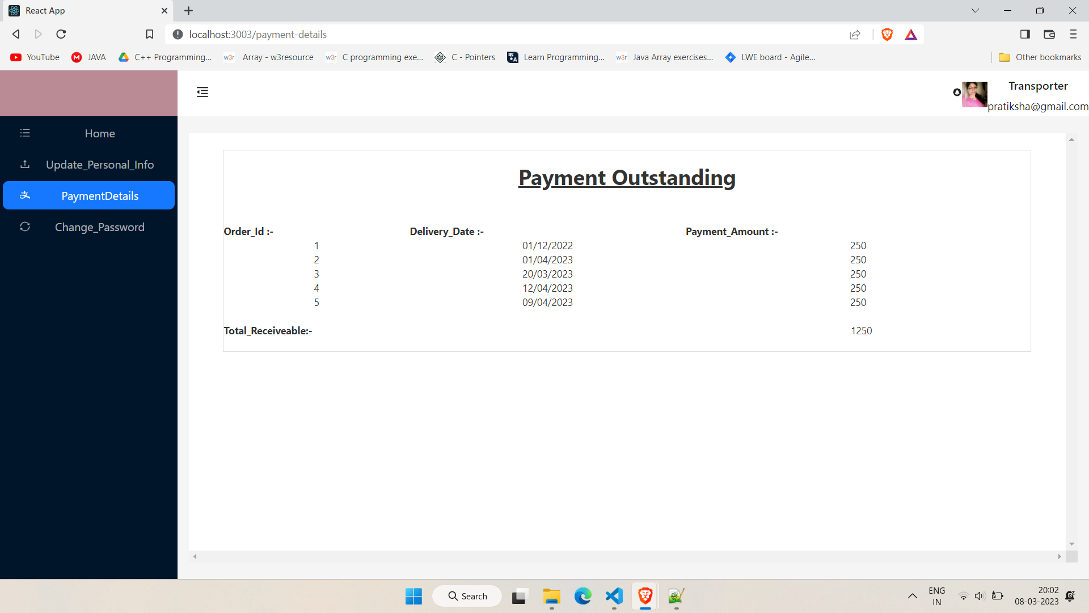
Payment Outstanding

Slide 24
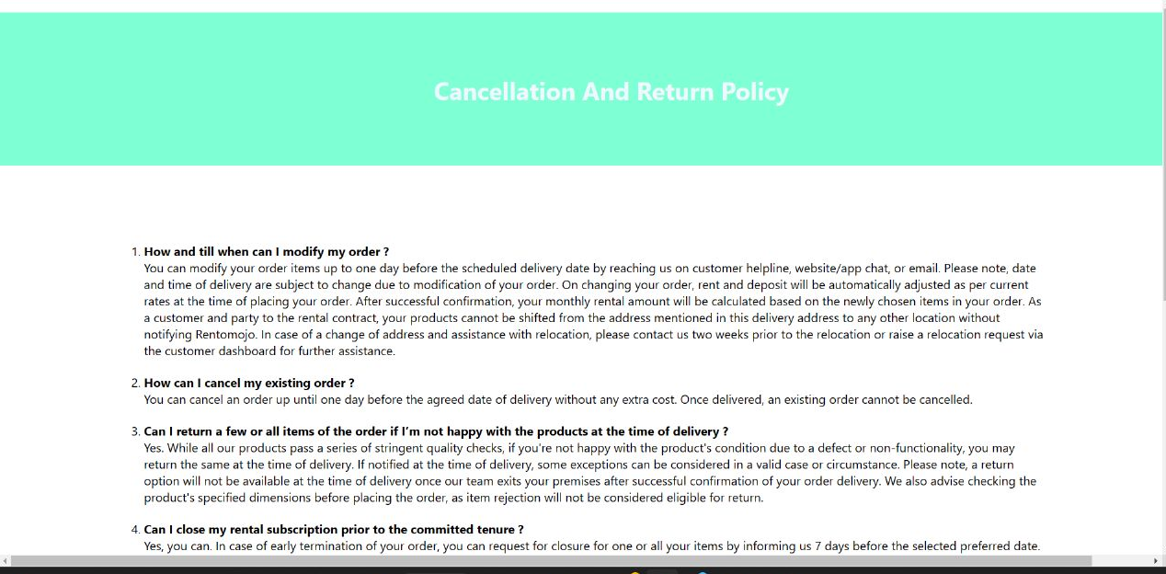
Cancellation & Refund Policy

Slide 25
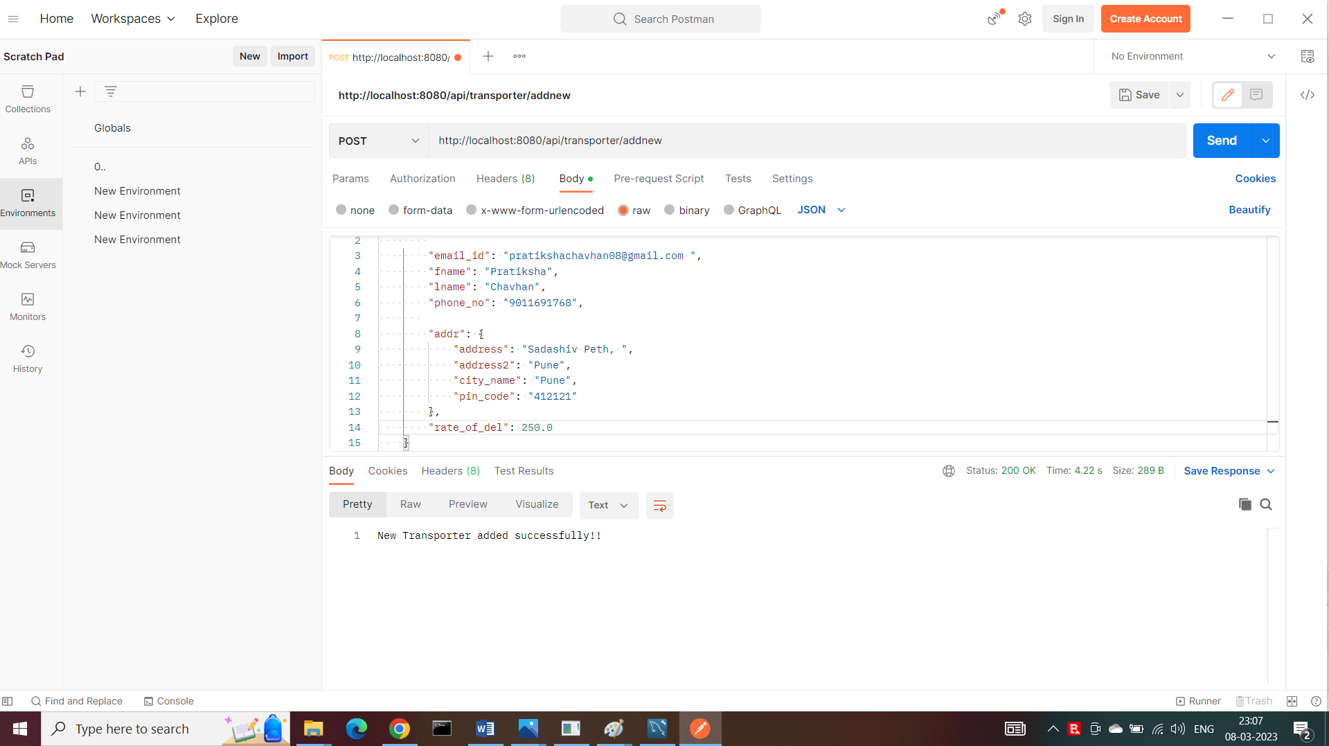
Sign up –Testing on Postman

Slide 26
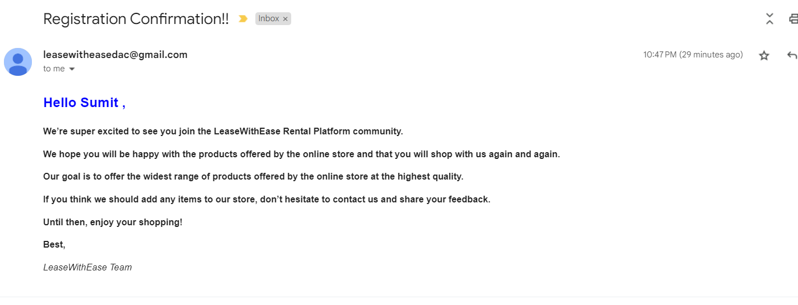
Confirmation mail to Customer on sign up

Slide 27
Add New Transporter By Admin

Slide 28
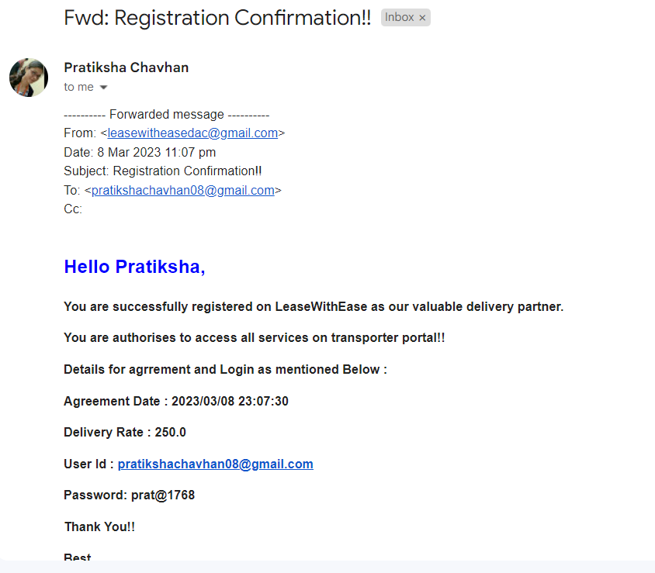
Mail to Transporter

Slide 29
Technologies Used

Slide 30
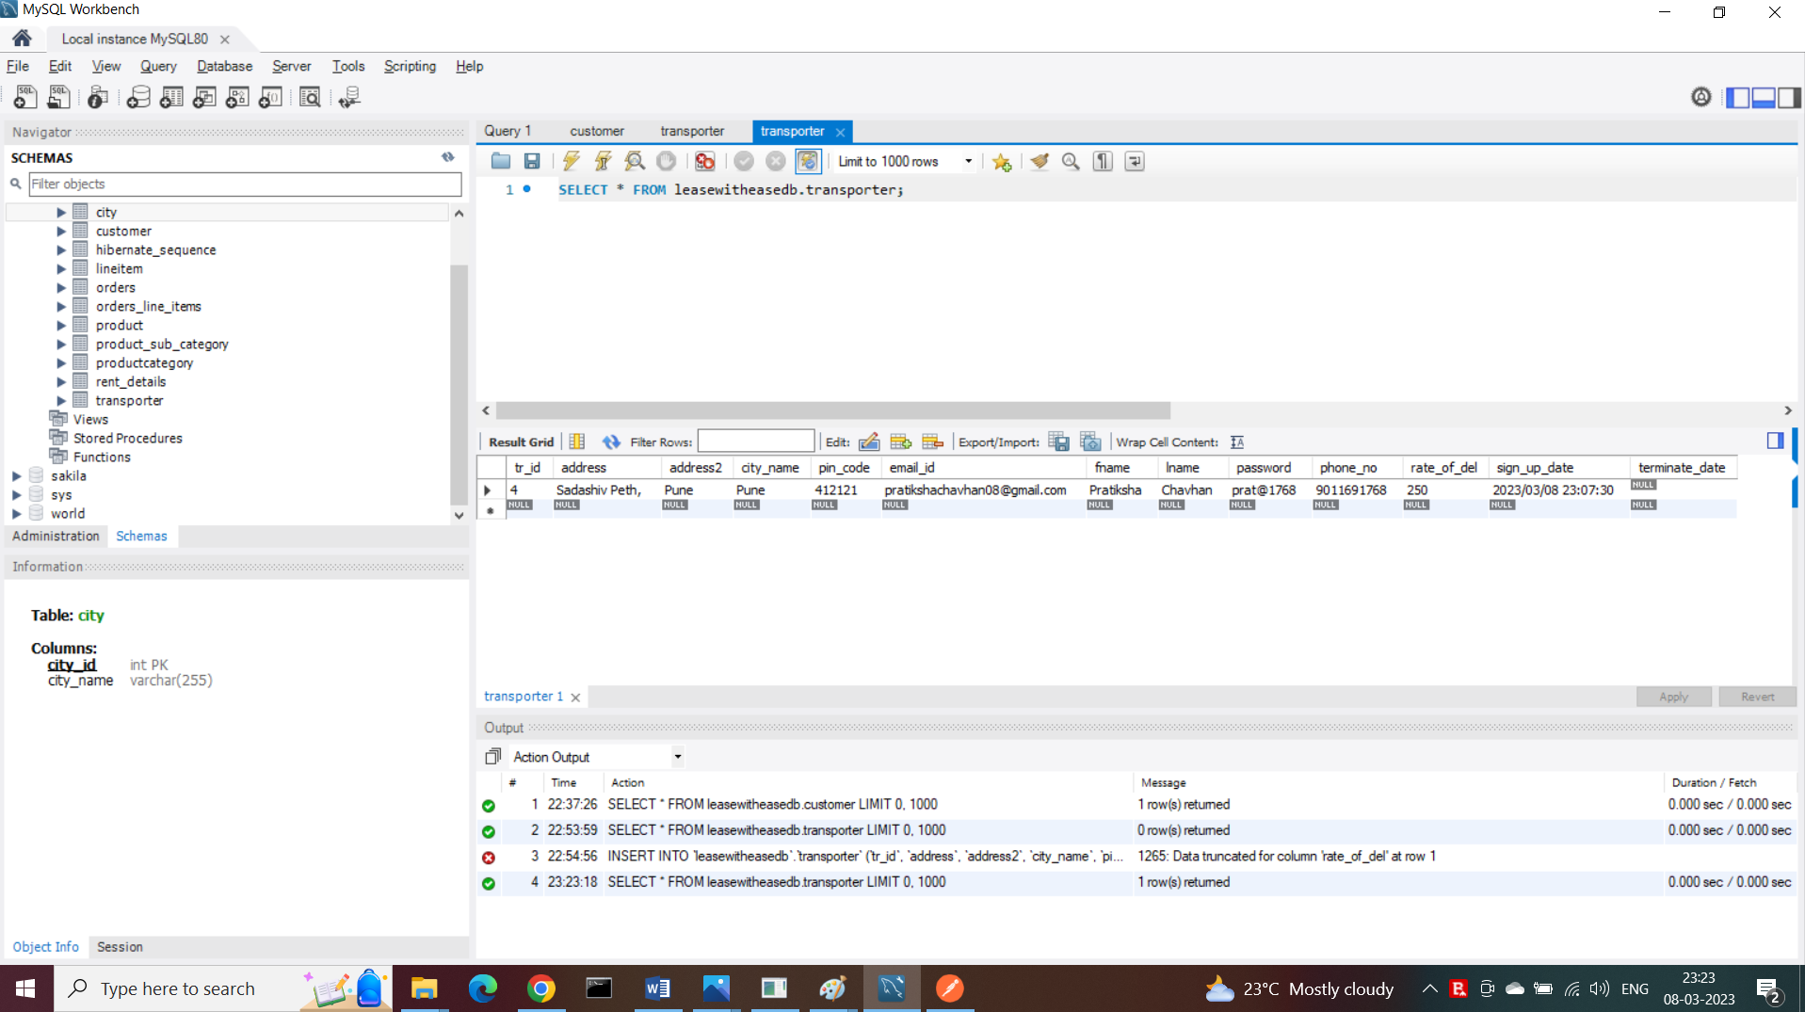
MYSQL Workbench

Slide 31
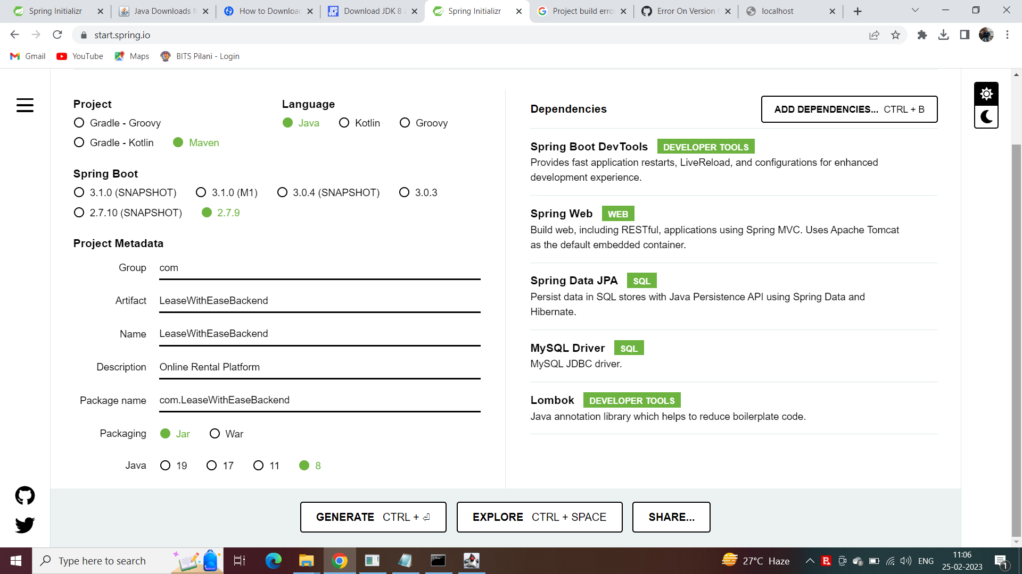
Spring Boot Maven Project using spring initializer

Slide 32
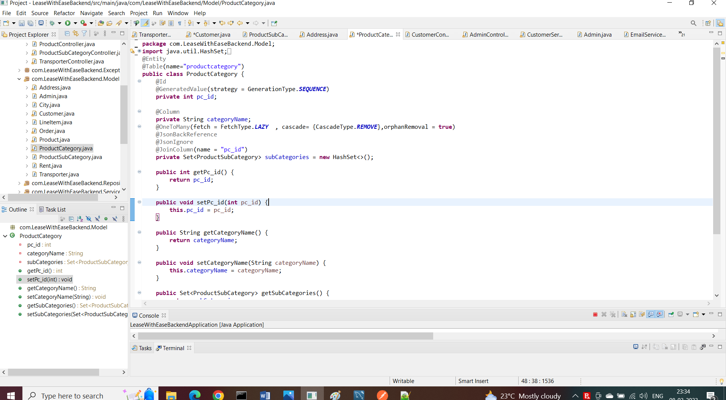
Eclipse IDE-2020 12

Slide 33
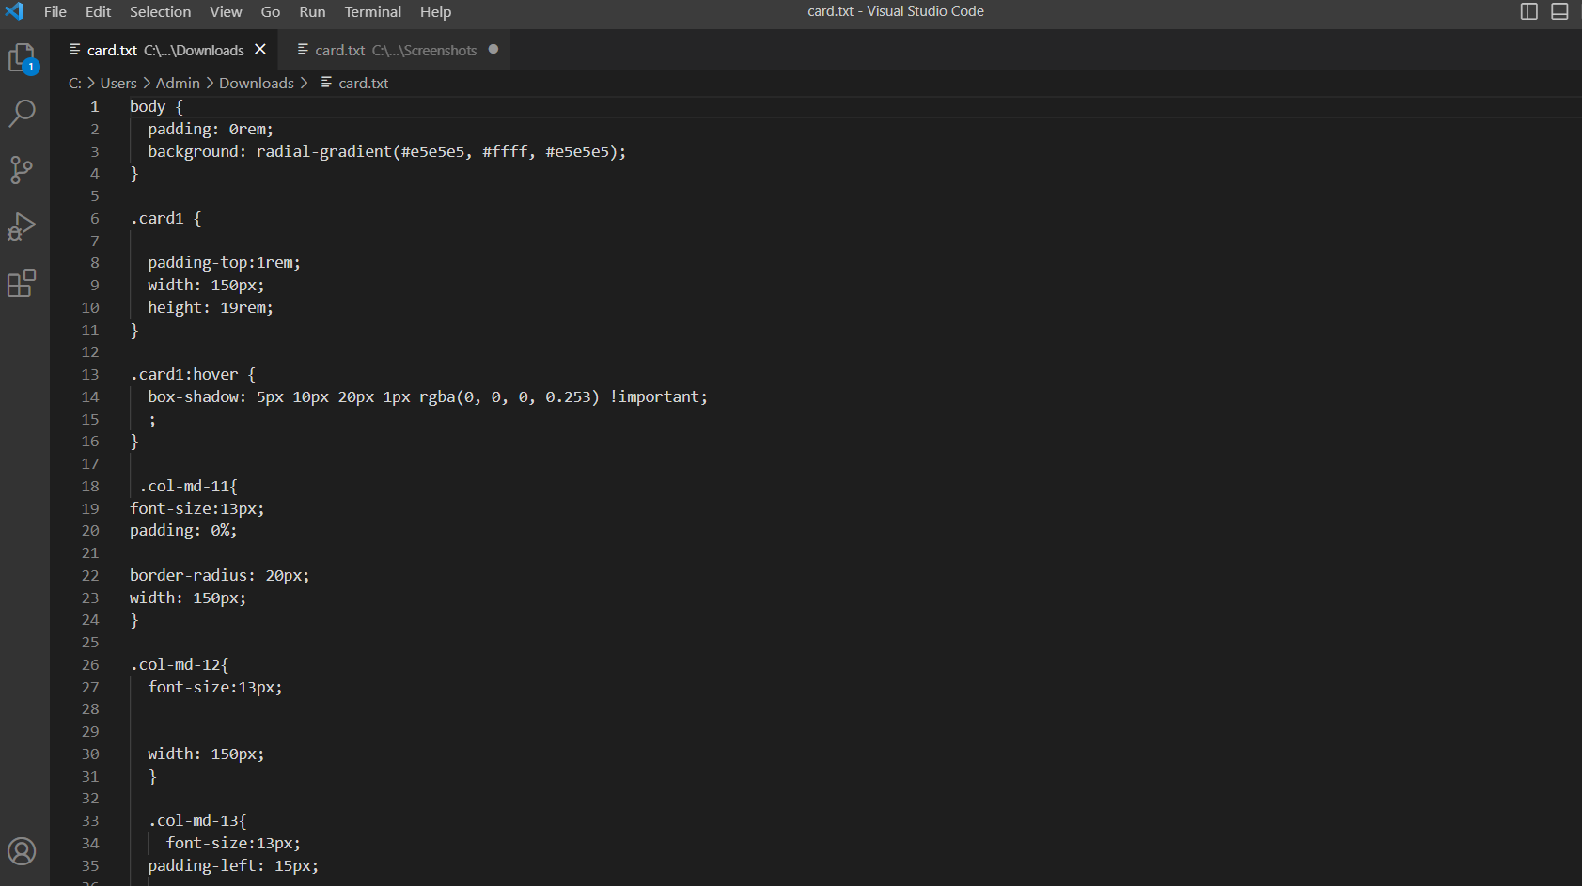
Visual Studio Code for React js

Slide 34
Hardware Configuration
Processor – Core i35
RAM – 8 GB RAM
Hard Disk – 1 TB
Key Board – Standard Windows Keyboard

Slide 35
Future Enhancement
Multiple Warehouses at various locations
Location wise Filtering
Recommendation
Comparison

Slide 36


